Slide 1
Simmons Catalogue
Logistic Regression

Slide 2
INDEX
Objective
Data Summary and Visualization
Exploratory Data Analysis and Preparation
Hypothesis and validation
Model implementation and strategy
Conclusion

Slide 3
Objective
Simmons’ catalogs are expensive and Simmons would like to send them to only those customers who have the highest probability of making a $200 purchase using the discount coupon included in the catalog.

Slide 4
Data Summary and Visualization
We have used Logit.csv file for our analysis as attached
This file has got total 5 variables of int/num datatype
Out of 5 variables, 3 are useful variables Spending, Card, Purchase
Total 100 records/observation
With Purchase rate ratio 2:5 –(Yes:No)

Slide 5
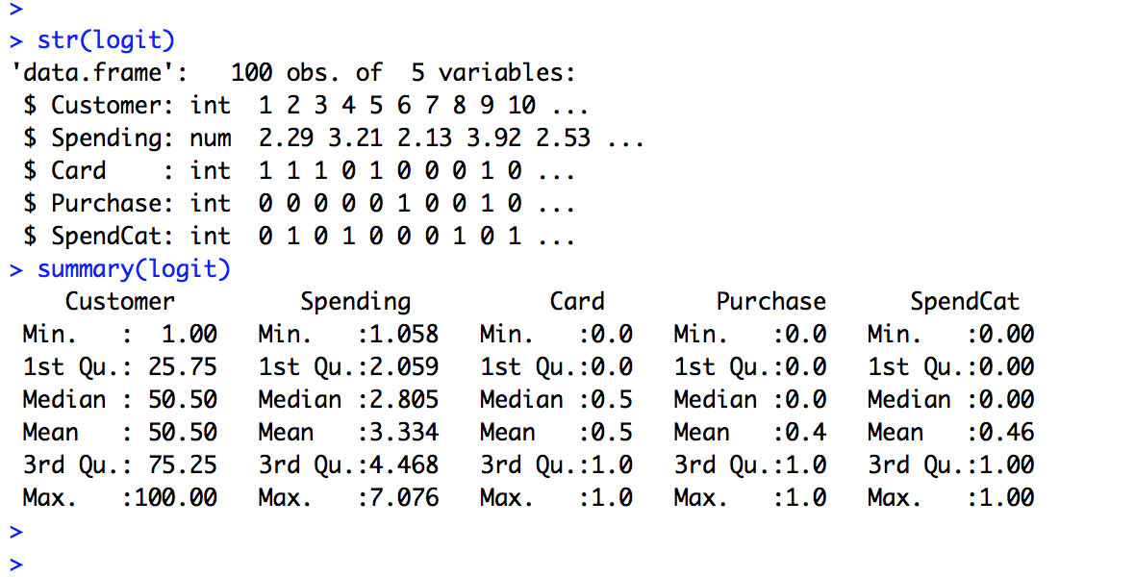

Slide 6
Exploratory Data Analysis & Preparation
Data Exploration is a crucial stage of predictive model. We can’t build great and practical models unless we learn and explore the data from begin to end.
This step can be done by visualization and analysis using excel/R
Variable Identification: This dataset has got 1 Response(Purchase) and 2(Spending and Card) predictor/explanatory variables (based on correlation plot)
We have not considered SpendCat – as no information provided in problem.

Slide 7
Exploratory Data Analysis & Preparation
Check For Missing Values in the Data set and replace with mode
Outlier Treatment
quantile(logit$Spending, c(0.05,0.1,0.2,0.3,0.4,0.50,0.6,0.7,0.8,0.9,0.95,0.99,1))
Correlation Plot
correlations <- cor(logit)
corrplot(correlations, method="number")
corrplot(correlations, method="circle")

Slide 8
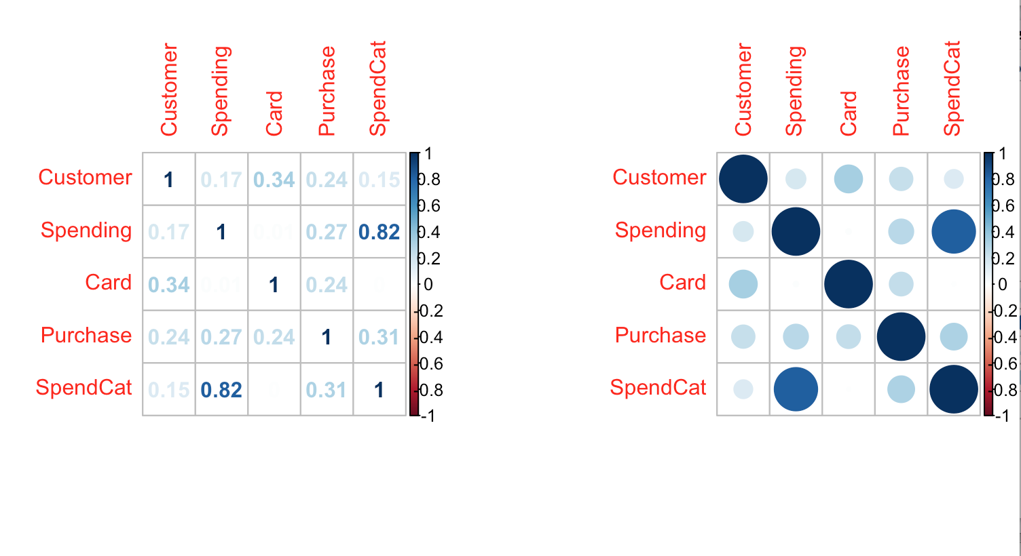

Slide 9
Exploratory Data Analysis & Preparation
Data preparation :
# Creating train and test Sample (70:30)
72 records for model train with purchase rate 43.05%
28 scaled unseen records as test sample with purchase rate ratio 32.14%
both above derived randomly from 100 records

Slide 10
Hypothesis
Null Hypothesis(Ho): Predictor variables in Logit dataset do not contribute to predict Purchase i.e. there is no linear relationship between customer purchase and all other predictor variables.
Alternate Hypothesis(H1): There is a linear relationship between customer purchase and predictor variables i.e. all or some have power to predict purchase.

Slide 11
Hypothesis validation using Linear regression
##Run Linear regression to find significant independent variables from Logit Data set
ft <- lm(Purchase ~ ., data = logit[, -c(1,5)])> summary(ft)
Result: p-value: < 0.001131
Assuming alpha value to be 0.01, p-value found is far below alpha and Hence, we can safely reject null hypothesis stating – some or all predictor variables in Logit dataset contribute to predict customer purchase

Slide 12
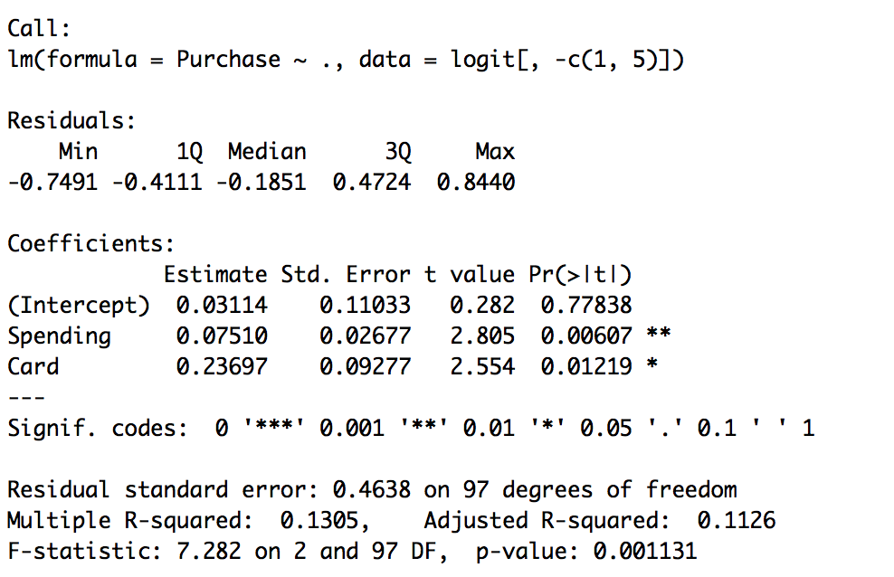
Hypothesis validation using Linear regression
Further , lmtest gives below list of significant variables from data set

Slide 13
Let’s build model now
Logistic Regression

Slide 14
Logistic Regression(LR)
How LR can help us infer and then predict purchase –
We build Full LR model using train dataset prepared in EDA&P
Using stepwise function we fine tune model significant variables
Create decile and then Rank order on train model based on predicted output
Calculate and print Rank table, auc, ks and confusion matrix on train. sample(refer screenshot on next slide)

Slide 15
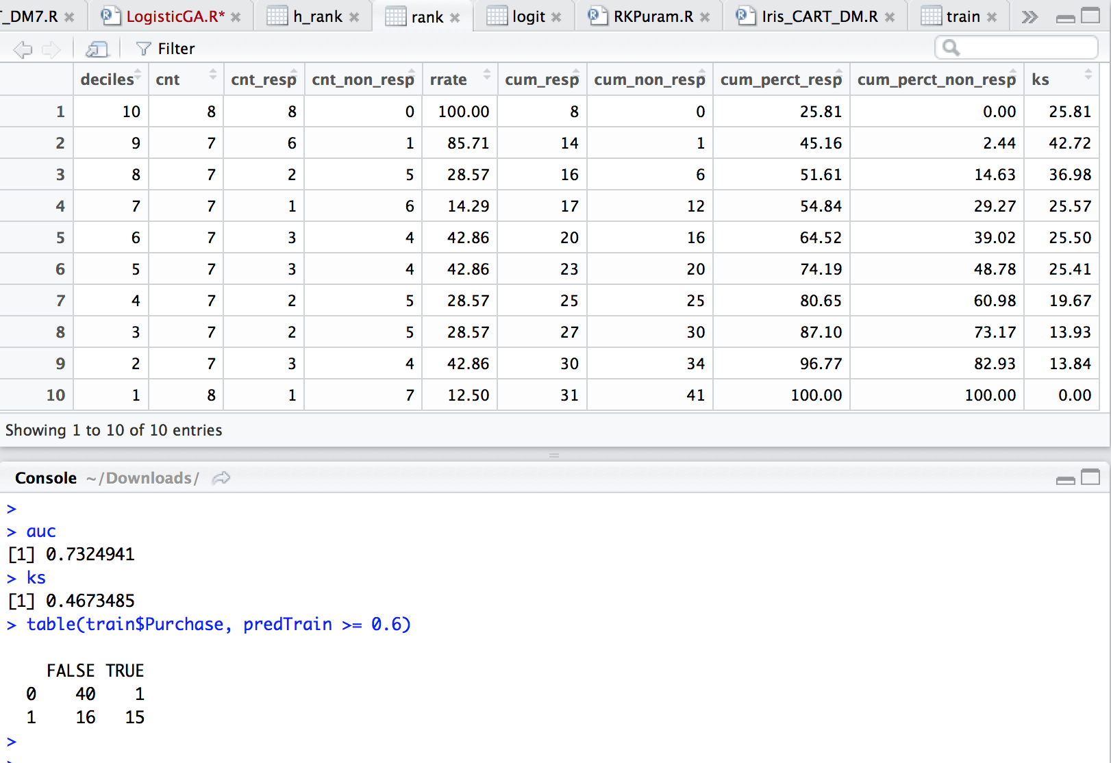

Slide 16
Analyzing LR train model performance
Looking at performance measure of train model :
Rank table: Top decile has 100% response rate i.e. 2.3times 43% overall response before applying LR algorithm.
Confusion Matrix: Correctness of prediction is 76.39%

Slide 17
Run LR model on test data

Slide 18
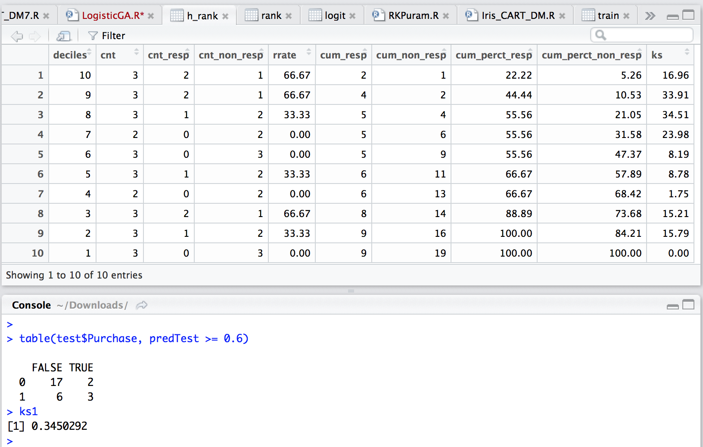

Slide 19
Analyzing LR model on unseen test data
Looking at performance measure of model on unseen data:
Rank table: Top decile has 66.67% response rate i.e. 2 times 32% overall response before applying LR algorithm.
Confusion Matrix: Correctness of prediction is 71.42%.

Slide 20
Conclusion
LR model works well for binary targets
From slide 19 – On unseen customers, we get twice the response rate in top decile compared to overall response without deploying model.

Slide 21
Thank You

